Slide 1
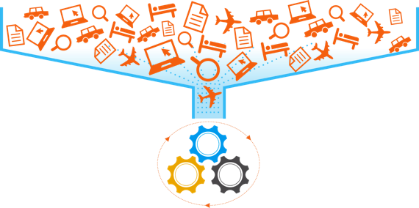
Sojern Traveler Platform
160MM Traveler Profiles + Billions of Data Points
Programmatic Buying Traveler Platform
Right Message + Right Format + Right Traveler + Right Time

